Slide 1
Algorithm for determining F4
AIH cases (n = 73)
Biopsy at sample collection?
YES
Determine fibrosis based on biopsy at sample collection (n = 8)
NO
Baseline bx w/in 6 mos of sample collection?
YES
Determine fibrosis based on baseline biopsy w/in
6 mos of sample collection (n = 11)
NO
Fibroscan >= 19 kPA or <13 kPA at sample collection?
Ruled IN as cirrhotic w/ fibroscan score >= 19 kPA (n = 8) or OUT if fibroscan score < 13 kPA (n = 23)
YES
NO
Fib 4 < 2.6 at sample collection?
YES
Ruled OUT as non-cirrhotic using Fib4 < 2.6 (n = 9)
NO
Undetermined samples
YES
Review of imaging (n = 2) / “overall” data from hepatologists (n= 2) / incomplete data (n = 10)

Slide 2
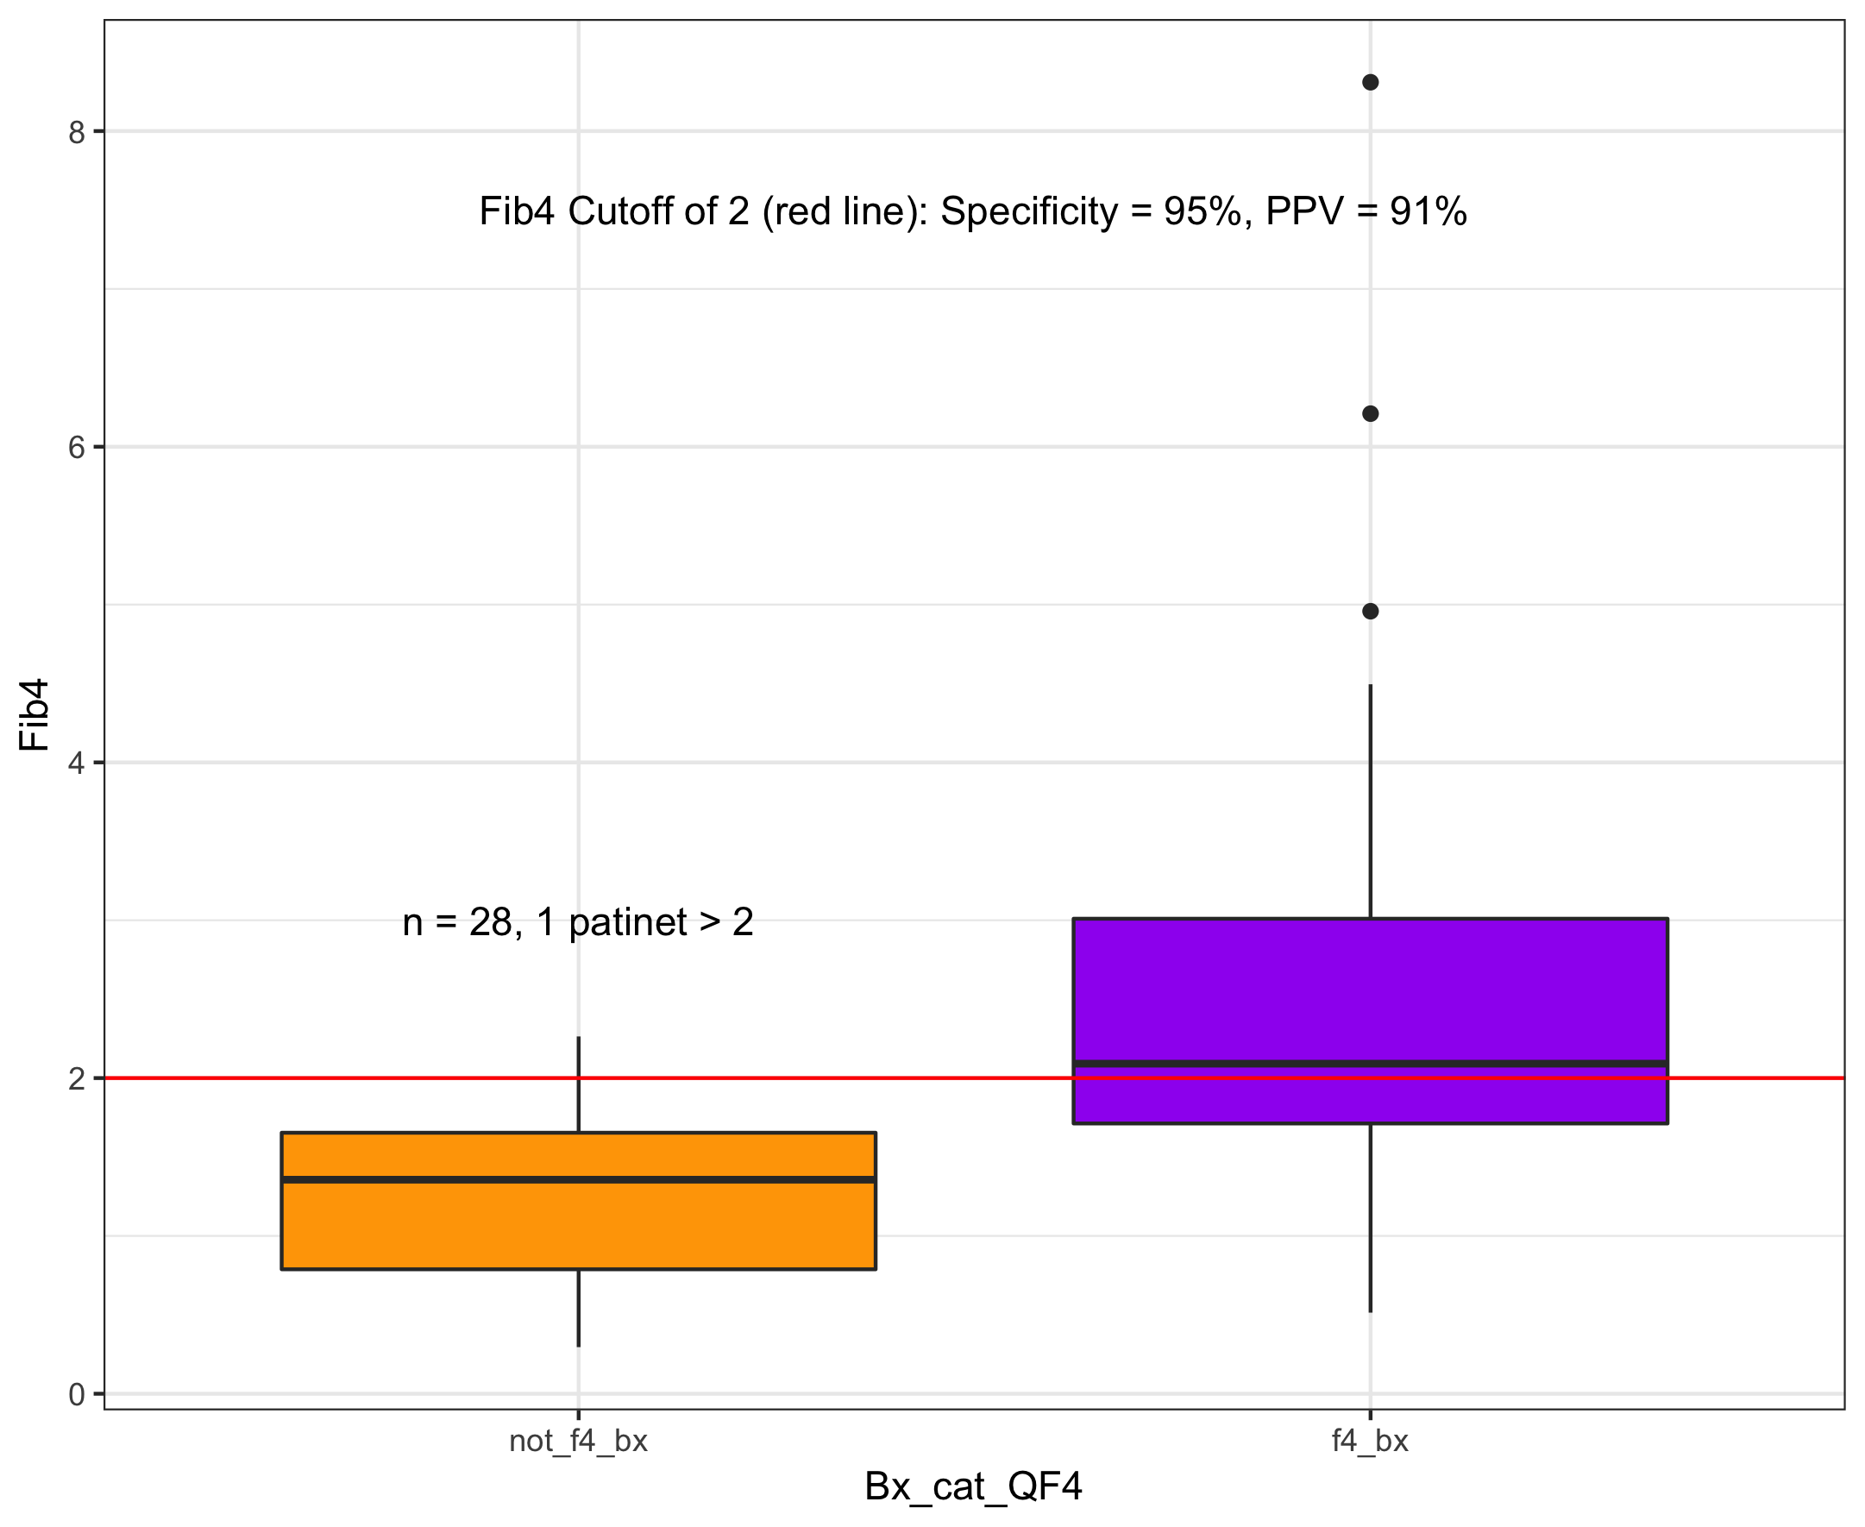
Validation of Fib4 for ruling in fibrosis

Slide 3
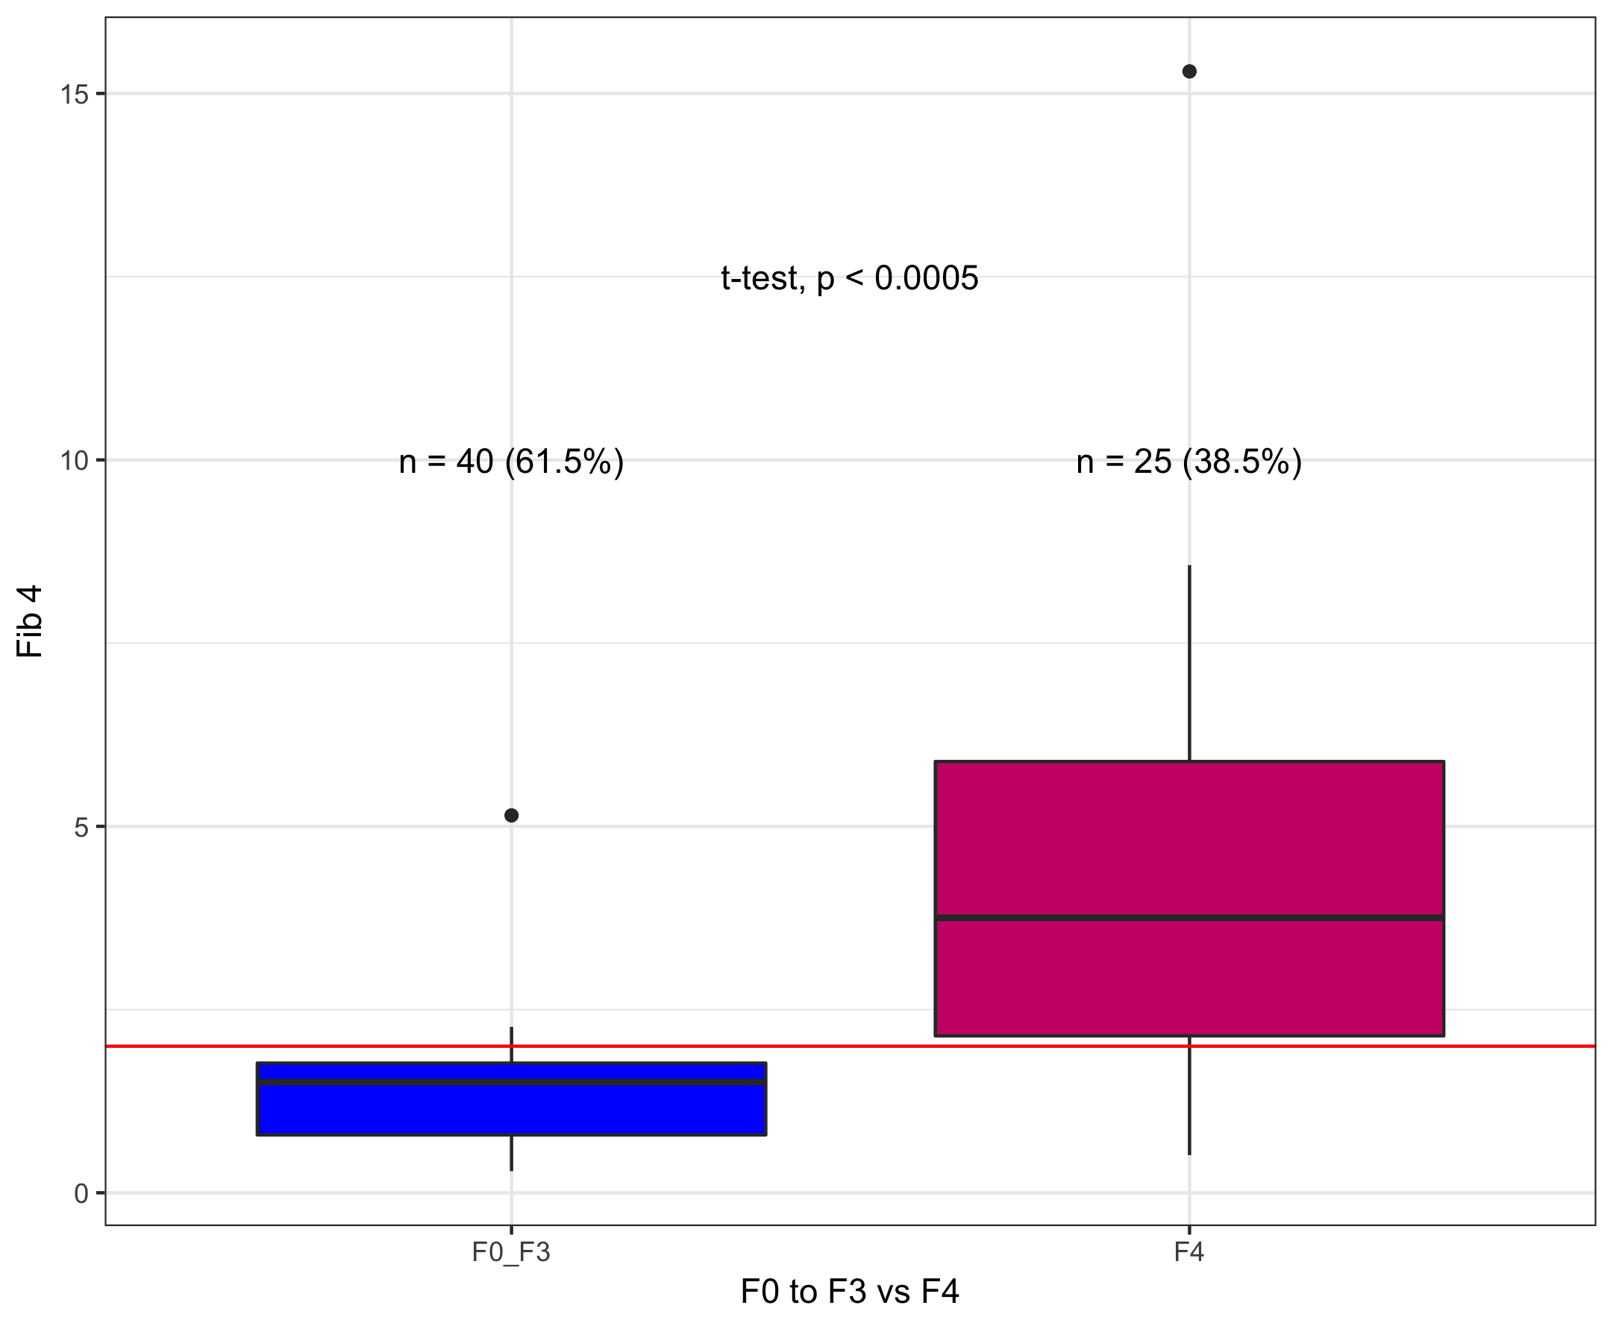
Fib 4 Score comparing F0-F3 to F4

